Slide 2
1989 “The Triumph of Capitalism”? or of balance? “The End of History”? or of thinking?

Slide 3
Pendulum politics between left and right or paralysis in the center
Left
Public
Communism (Marx)
Democracy of the “Proletariat”
Nationalization
_______________
Occupations
Right
Private
Capitalism (Smith)
“Free Enterprise”
Privatization
______________
Tea Parties

Slide 4
Three Pillars for a Balanced Society
Public sector
(political)
Private sector
(economic)

Slide 5
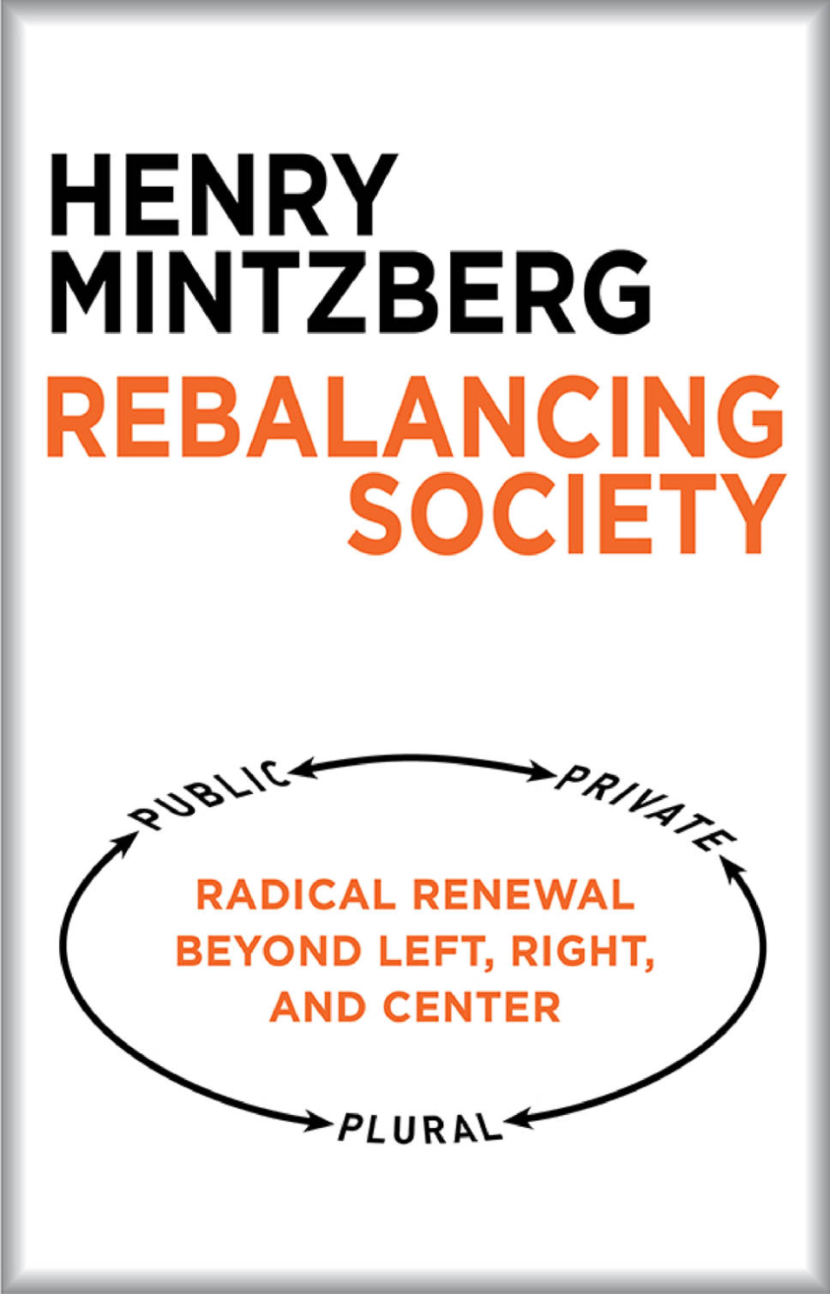

Slide 6
The Plural Sector
Why “Plural”?
_______________________________________________________
Institutions: Member-owned
Non-owned
Associations: Social movement s (confrontation)
Social initiatives (circumvention)
_______________________________________________________
Commons and Communityship

Slide 7
But dangers at the limit…. Public Sector is crude Private Sector is crass Plural Sector is closed

Slide 8
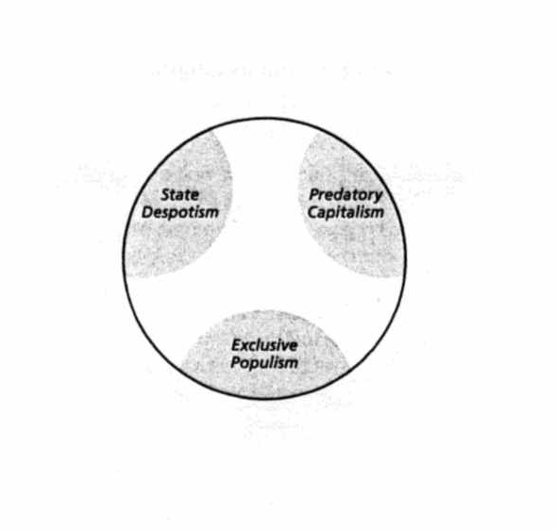
Imbalance and Balance
Engaging Responsible
Democracy Enterprise

Slide 9
Radical Renewal
Don’t wait for governments
And don’t expect miracles from “CSR”
(There is no win-win wonderland)

Slide 10
Look instead to the Plural Sector
Social initiatives (a million worldwide)
Mass movements (from local communities into global networks)
Autonomous “associations”
You, me, and we
but
The BIG Question
How to get our collective act together?

Slide 11
“We have it in our power to begin
the world over again.”
Tom Paine (1776)
Again!

